Slide 1
FHIM Overview 16 August 2016
Galen Mulrooney
supporting VHA KBS Health Standards Program

Slide 2
Background: FHA projects
An important goal of the FHA is to enable interoperability between partner agencies and with their private sector partners, and have several projects towards that goal
Interoperability is facilitated when agency enterprise architecture components are closely aligned with Health IT Standards
However, there are gaps and overlaps between the standards
Many standards leave some details to the implementers, especially choices in terminologies used.
One FHA project, the Federal Health Information Model (FHIM) seeks to harmonize the information requirements of the partner agencies, thereby forming a basis for their information architectures
Notes:
Please use the slide construction guidelines included on the next slide within your presentation.

Slide 3
What is the FHIM?
The FHIM is a Logical Information Model, expressed in UML, of the data needed by Federal Agencies to conduct Healthcare operations, aligned with industry standards as required by regulation
Logical Information Model: serves as the basis of each Agency’s Data Reference Model (DRM), making the FHIM an Enterprise Architecture artifact
Federal Agencies: The FHIM fills in the gaps left by generic industry standards by identifying U.S. data and terminology requirements (e.g., RxNorm for medications)
Standards and Regulations: The FHIM is a superset of the industry standards required by HIPAA, ARRA, and Meaningful Use, as well as emerging standards such as FHIR, Care Plan, and Security/Privacy
Expressed in UML: This allows FHIM models to be transformed into other models fit for particular purposes.

Slide 4

Benefits of FHIM Information and Terminology Models
The models support efficient standards development
Standard ballot materials can be generated from the FHIM
The models are being integrated with the Model Driven Health Tools (MDHT) to support a model-driven approach to development of information exchange interoperability specifications
FHIM maintains traceability to underlying standards - especially HL7, NCPDP, and X12 – as well as to S&I Initiatives
FHIM derivative models add “interoperability use cases”, which provide additional constraints. These derivative models maintain traceability to the use cases and to the HL7 EHR-S Functional Model
The models can be leveraged by organizations for internal use in systems and database development

Slide 5
Benefits of Model-Driven Approach
Analyze once implement many times
Business/clinical concepts are the same regardless of what technology (or standard) in which they’re implemented
Provide consistency across the conceptual “landscape”
Each information exchange structure or detailed clinical model is consistent with others
Enables generation of code to reduce cost and human-introduced errors
Enables generation of other artifacts (e.g., implementation guides, developer interactive help)
Allows for transition from one information exchange format to another

Slide 6
Suggested VA Strategy with respect to the FHIM
The FHIM is a unified view of all the standards important to VA
Continue to incorporate emerging standards into the FHIM, especially FHIR, CIMI, KBS Terminology initiatives (e.g., Logical Expressions), Security / Privacy, Care Plan, and Clinical Decision Support
This involves both direct participation in FHIM modeling as well as participation in Standards Development initiatives
The FHIM is meant to guide agency implementation
Liaise with major VA projects such as eHMP to educate developers on FHIM and the standards underlying the FHIM, and to elicit VA requirements for the FHIM
The FHIM is the basis for Agency Data Reference Models
Work with ASD and VHA BIA to maintain the VA DRM

Slide 7
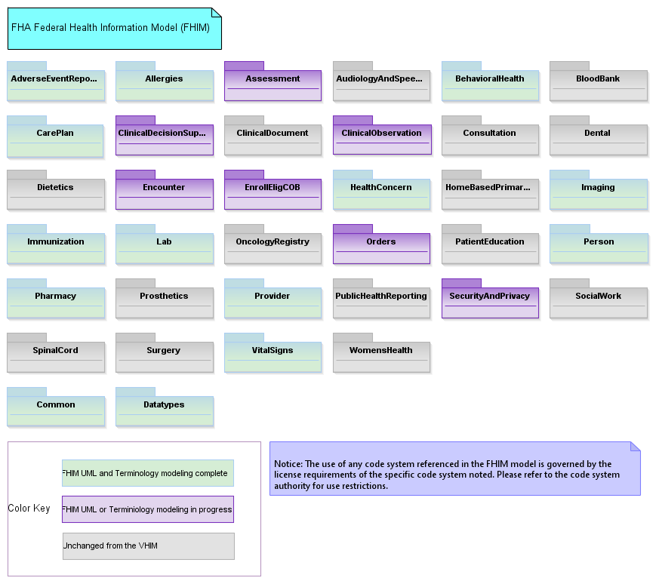
The FHIM Main Diagram

Slide 8
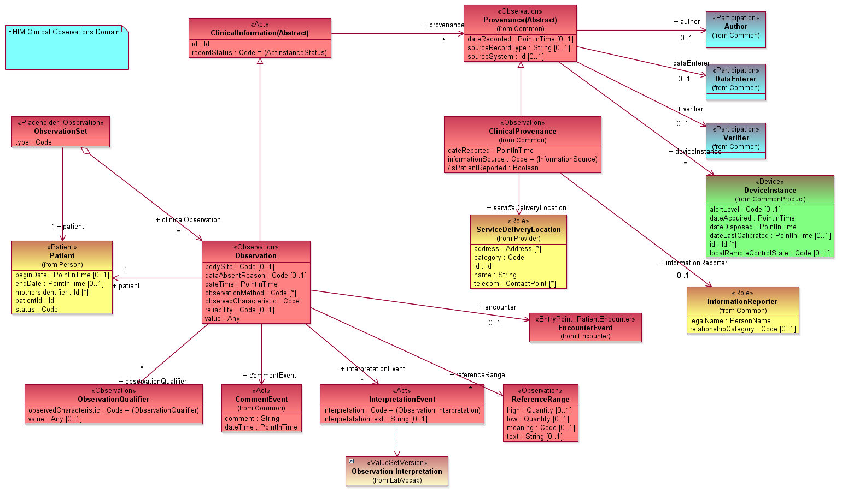
FHIM Clinical Observation

Slide 9
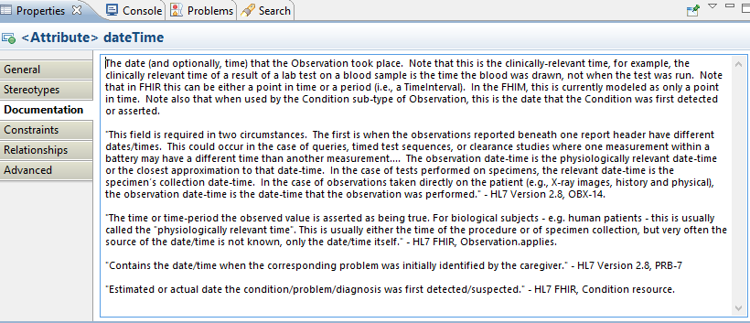
Documentation

Slide 10
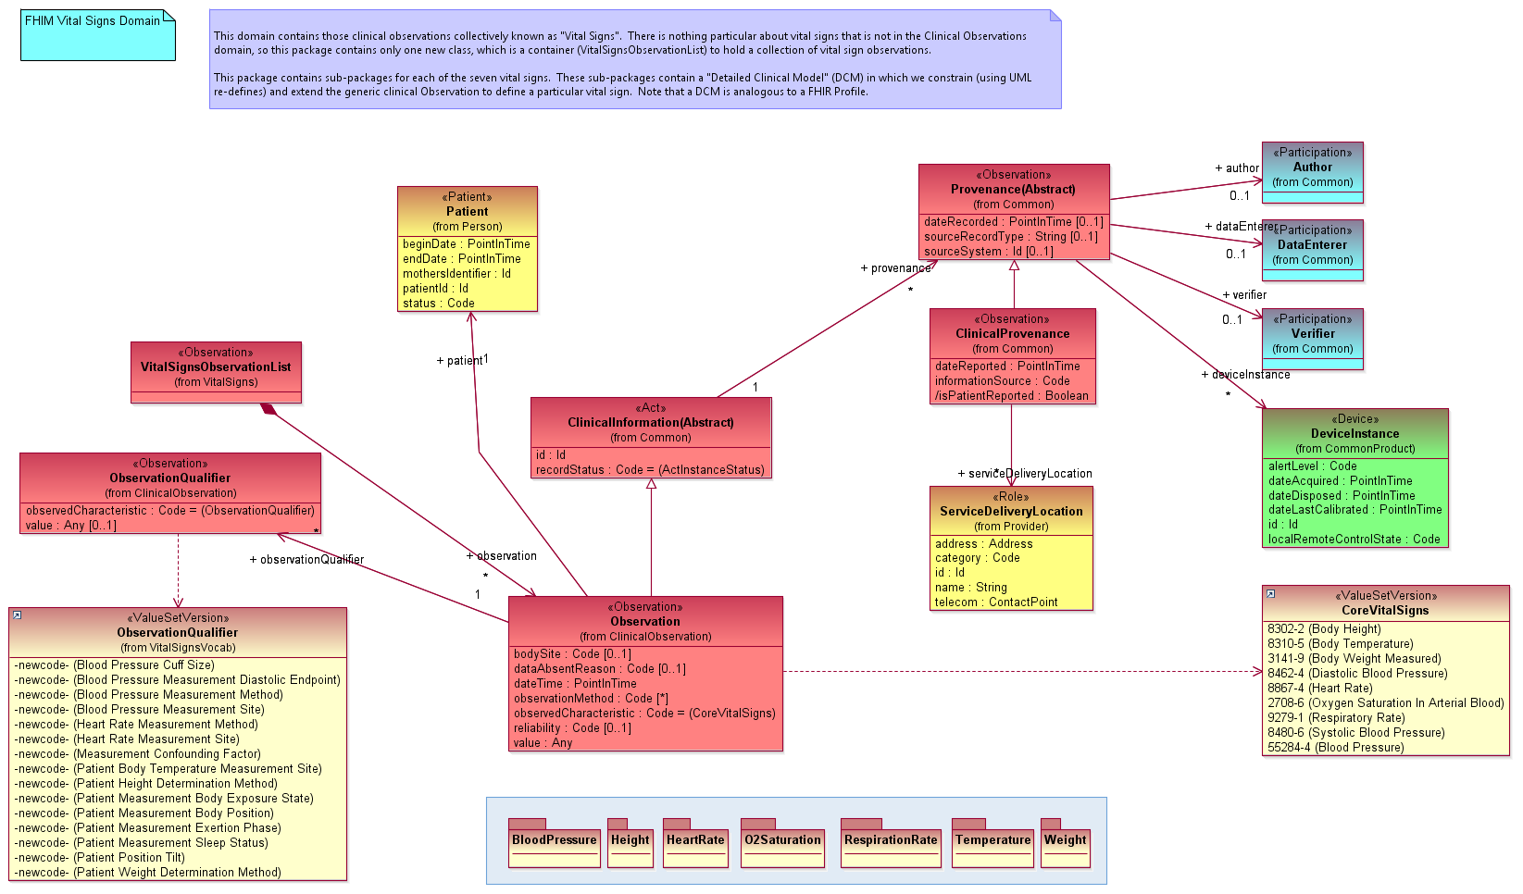
FHIM Vital Signs

Slide 11
FHIM “Detailed Clinical Models”
The FHIM primarily models generic structures like “Vital Signs”, which can accommodate any Vital Sign
Consistent with the approach of most standards
But we can create DCMs using UML “re-defines”
A re-define allows one to constrain a UML model by re-defining in a sub-type a property that was introduced in its super-type
The following slides show the Heart Rate DCM

Slide 12
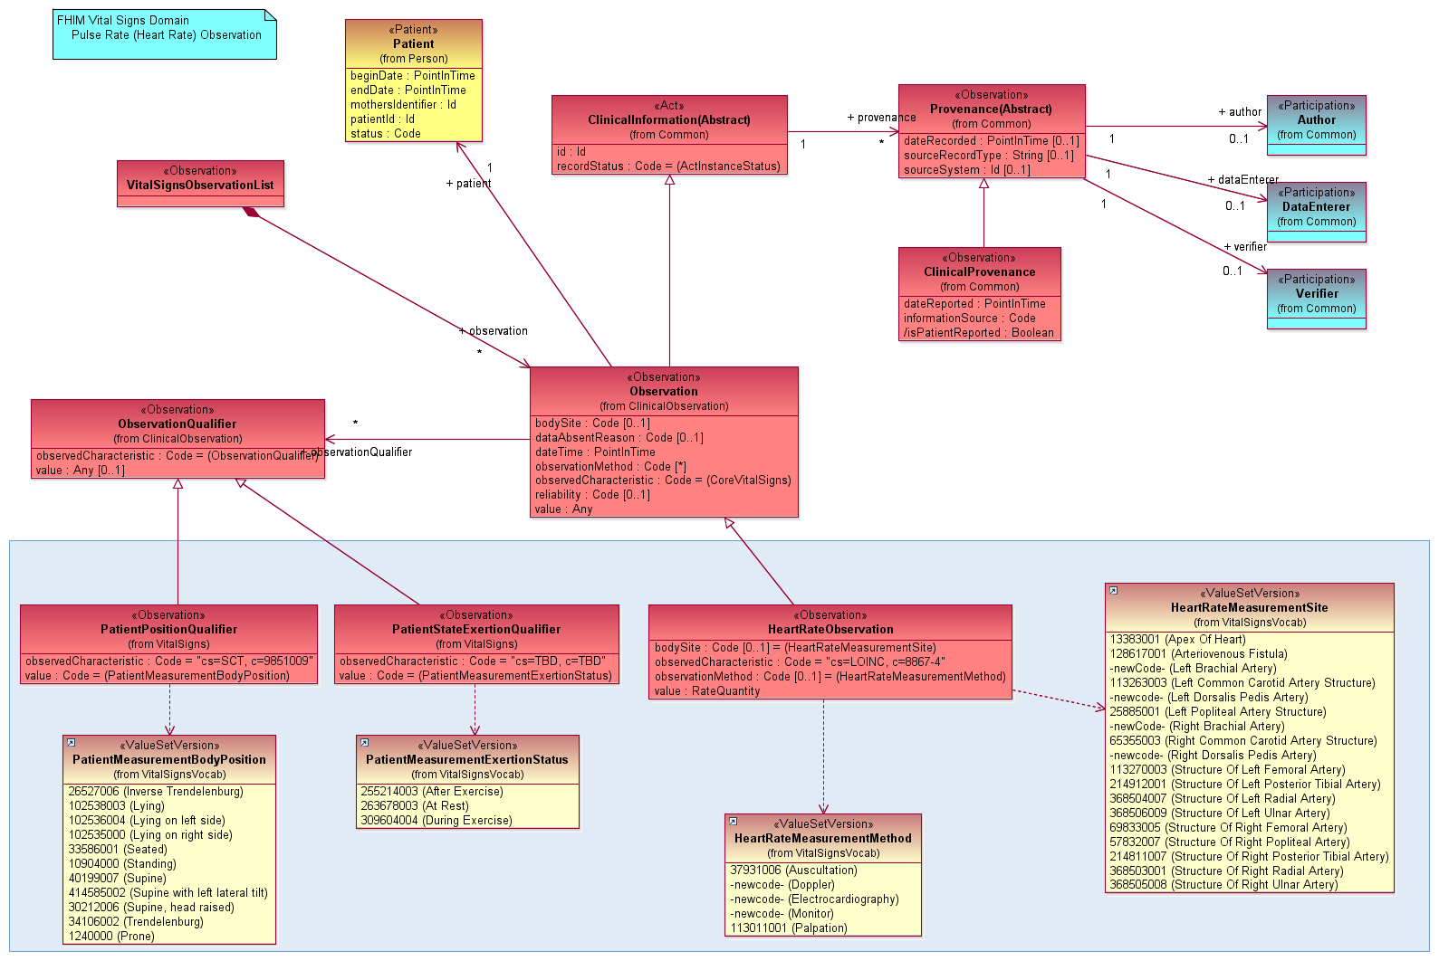
FHIM Vital Signs: Heart Rate

Slide 13
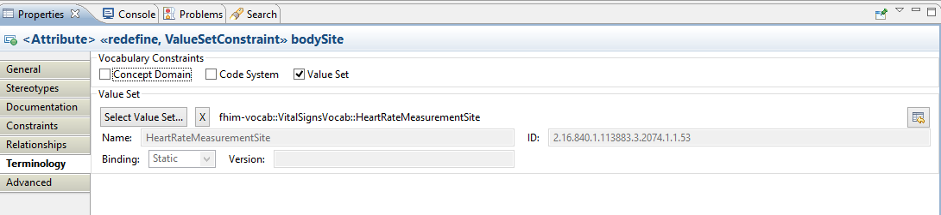
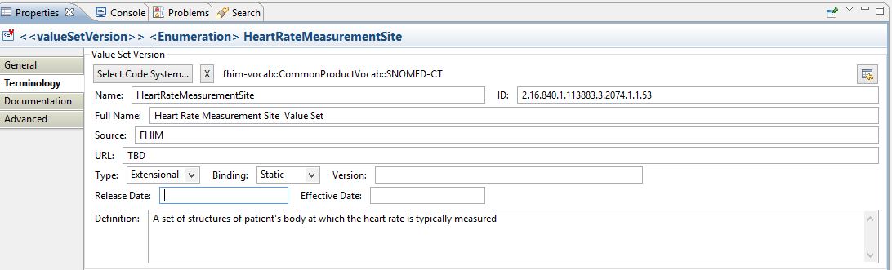
Terminology binding in the FHIM
Once the value set is created VSAC, this will point to the page where it can be viewed

Slide 14
FHIM “Detailed Clinical Models”
We have demonstrated how DCMs can be modeled in the FHIM
But, while we “hand-built” the Vital Signs DCMs, we do not envision doing so for every DCM. We contend that the majority of DCMs should be generated from a knowledge base
Each DCM represents a set of possible values in the “code” and the “qualifiers” that could be related to post-coordinated concepts in a medical ontology (e.g., SOLOR).
Once generated into UML, the FHIM could then be used to generate implementable artifacts in multiple standard formats (e.g., FHIR, CDA, etc.)

Slide 15
Benefits
The FHIM provides the “missing logical model,” the absence of which hinders some standards individually, and the corpus of standards to which organizations must comply
In combination with MDHT, the FHIM can generate service payloads, both at the coarse grained level (e.g., Vital Signs) and at the fine grained level (e.g., Heart Rate)
Those payloads can be expressed in standard-compliant formats, e.g., a FHIR JSON instance, or an HL7 v2 message.
Other code can be generated, including code to test conformance of the payloads

